Slide 1
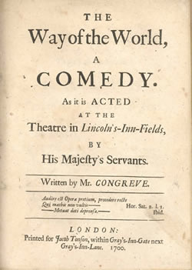
The Way of the World
William Congreve
http://www.bl.uk/reshelp/images/earlyprint/large14582.html

Slide 2
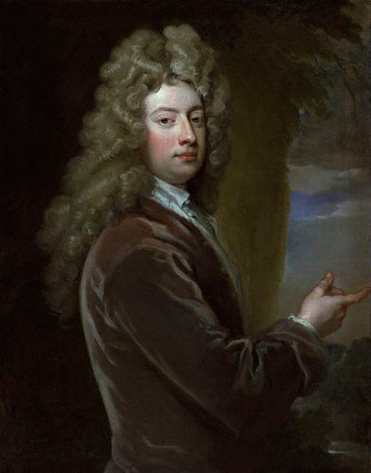
William Congreve
1670 — 1729
Father a Cavalier with
Disciple of John Dryden
Produced five popular plays
http://en.wikipedia.org/wiki/File:William_Congreve.jpg

Slide 3
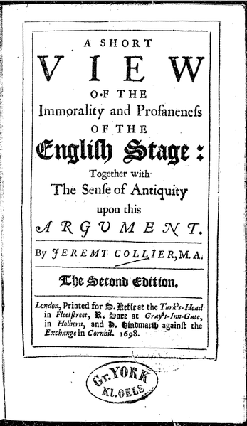
Career ended in 1700 and he shifted to politics
Said to be stung by Collier’s critique of the theatre (1698); wrote a rebuttal, “Amendments to Mr. Collier’s False and Imperfect Citations”
http://en.wikipedia.org/wiki/File:ShortView1698.png

Slide 4
The Restoration Period
The term Restoration drama, usually applied to the plays written during the period from 1660 to 1700 , is not really satisfactory. Charles II was restored to the English throne in 1660.
By 1700, Charles II had died, his brother James had reigned for five years and had been deposed in the "glorious revolution," or "bloodless revolution," of 1688, and William and Mary had reigned for twelve years.
The Way of the World was first presented when William was thirty. By that time, some of the most obvious and most notorious features of the period no longer existed or existed only in much weaker forms.
The Restoration period is to think of it as a reaction against the Puritanism of Cromwell and the period of the Commonwealth.

Slide 5
Comedy of Manners
Height of popularity 1660 — 1700
The Way of the World considered exemplary
Good manners valued over good morals
Characterized by witty dialogue and emphasis on sexual relationships

Slide 6
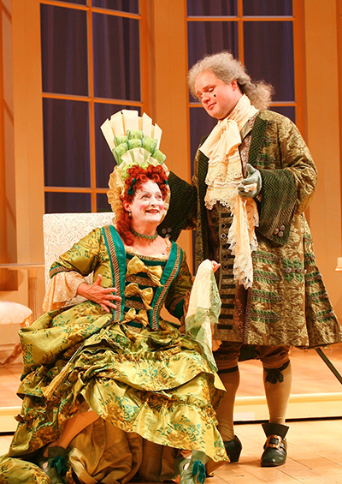
Immorality?
Inducing audience to immoral behaviour, or a reflection of unpleasant social truths?
http://www.shakespearetheatre.org/plays/photos.aspx?id=145

Slide 7
Wit
Come, come, leave business to idlers, and wisdom to fools: they have need of 'em: wit be my faculty, and pleasure my occupation, and let father Time shake his glass.
Congreve, The Old Bachelor

Slide 8
Wit
Half wits, false wits, and true wits

Slide 9
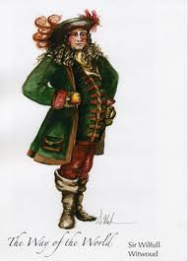
Half wits?
Witwoud, Wilfull
http://www.finearts.utexas.edu/tad/productions/production_season/2006-2007/way_of_the_world/costume_sketches.cfm

Slide 10
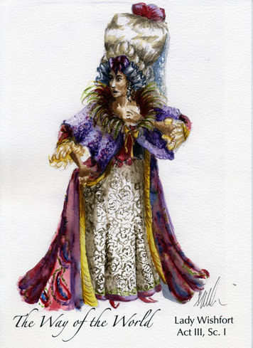
False Wits?
Wishfort, Marwood
http://www.finearts.utexas.edu/tad/productions/production_season/2006-2007/way_of_the_world/costume_sketches.cfm

Slide 11
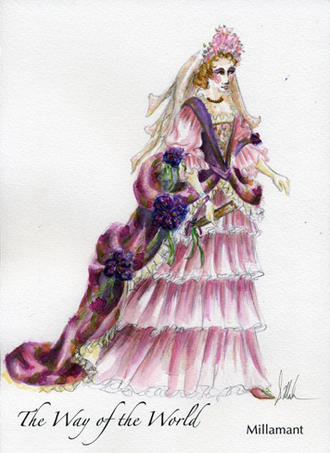
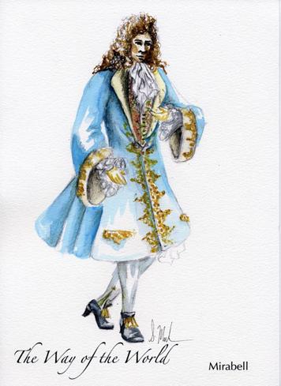
True wits?
Millamant, Mirabell
http://www.finearts.utexas.edu/tad/productions/production_season/2006-2007/way_of_the_world/costume_sketches.cfm

Slide 12
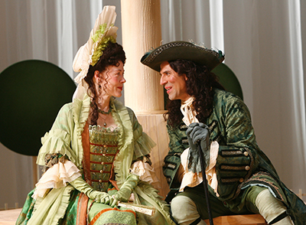
Marriage
The “Proviso” scene as microcosm and symbol
http://www.shakespearetheatre.org/plays/photos.aspx?id=145

Slide 13
A THEMATIC ANALYSIS
Act 1 is set in a chocolate house where Mirabell and Fainall have just finished playing cards. A footman comes and tells Mirabell that Waitwell who is Mirabell's male servant and Foible who is Lady Wishfort’s female servant were married that morning. Mirabell tells Fainall about his love of Millamant and is encouraged to marry her.
Witwoud and Petulant appear and Mirabell is informed that should Lady Wishfort marry, he will lose £6000 of Millamant’s inheritance. He will only get this money if he can make Lady Wishfort consent to his and Millamant’s marriage.
Act 2 is set in St. James’ Park. Mrs. Fainall and Mrs. Marwood are discussing their hatred of men. Fainall appears and accuses Mrs. Marwood of loving Mirabell . Meanwhile, Mrs. Fainall tells Mirabell that she hates her husband, and they begin to plot about tricking Lady Wishfort to give her consent to the marriage.
Millamant appears in the park, and angry about the previous night when Mirabell was confronted by Lady Wishfort , she lets him know her displeasure in Mirabell’s plan, which she only has a vague idea about. After she leaves, the newly wed servants appear and Mirabell reminds them of their roles in the plan.

Slide 14
Acts 3, 4 and 5 are all set in the home of Lady Wishfort. We are introduced to Lady Wishfort who is encouraged to marry ‘Sir Rowland’ – Mirabell’s supposed uncle – by Foible so that Mirabell will lose his inheritance. However Sir Rowland is Waitwell in disguise, the plan being to arrange a marriage with Lady Wishfort, which cannot go ahead because it would be bigamy, not to mention a social disgrace.
Waitwell is only a serving man, Lady Wishfort an aristocrat. Mirabell will offer to help her out of the embarrassing situation if she consents to his marriage. Later, Mrs. Fainall discusses this plan with Foible, but this is overheard by Mrs. Marwood. She later tells the plan to Fainall, who decides that he will take his wife’s money and go away with Mrs. Marwood.
Mirabell and Millamant, equally strong-willed, discuss in detail the conditions under which they would accept each other in marriage, showing the depth of feeling for each other. Mirabell finally proposes to Millamant and, with Mrs. Fainall’s encouragement which is almost consent, as Millamant knows of their previous relations, Millamant accepts.
Mirabell leaves as Lady Wishfort arrives, and she lets it be known that she wants Millamant to marry her nephew, Sir Wilful, who has just arrived from the countryside. Lady Wishfort later gets a letter telling her about the Sir Rowland plot.

Slide 15
Sir Rowland takes the letter and accuses Mirabell of trying to sabotage their wedding. Lady Wishfort agrees to let Sir Rowland bring a marriage contract that night.
By Act 5, Lady Wishfort has found out the plot, and Fainall has had Waitwell arrested. Mrs. Fainall tells Foible that her previous affair with Mirabell is now public knowledge. Lady Wishfort appears with Mrs. Marwood, whom she’s thanking for unveiling the plot.
Fainall then appears and uses the information of Mrs. Fainall’s previous affair with Mirabell and Millamant's contract to marry him to blackmail Lady Wishfort, telling that she should never marry and that she is to transfer all the money over to him. Lady Wishfort tells Mirabell that she will offer consent to the marriage if he can save her fortune and honor.
Mirabell calls on Waitwell who brings a contract from the time before the marriage of the Fainalls in which Mrs. Fainall gives all her property to Mirabell. This neutralises the blackmail attempts, after which Mirabell restores Mrs. Fainall’s property to her possession and then is free to marry Millamant with the full £6000 inheritance.

